Slide 1
Environment Set UP for BMP280 Sensor with Android Things
Notes:
Reference:
https://github.com/androidthings/drivers-samples/tree/master/bmx280
https://github.com/androidthings/contrib-drivers/tree/master/bmx280

Slide 2



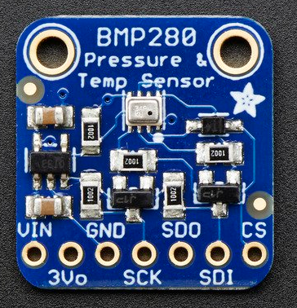

Environments
Environment For Raspberry pi 3 Model B
Devices
Raspberry pi 3 model B
BMP 280
Platform
Android things
Environment For Desktop
OS
Window 10
Software
Android Studio
Android Debug Bridge (ADB)
Notes:
Peripheral I/O: communication APIs to sensors and actuators
General Purpose Input/Output(GPIO):
use to read the state of a binary input device and control the on/off state of a binary output device
Adding permission to manifest file
Connect port: in order to open connection to a CPIO port you will using unique GPIO port name to open connection.
Read:
setDirection() with DIRECTION_IN
Current state by getValue()
Close connection: in order to free up resources.
Pulse Width Modulation(PWM): use to control actuators
Serial Communication: use to transfer larger payloads of data between two or more smart devices connected on the same local bus.

Slide 3
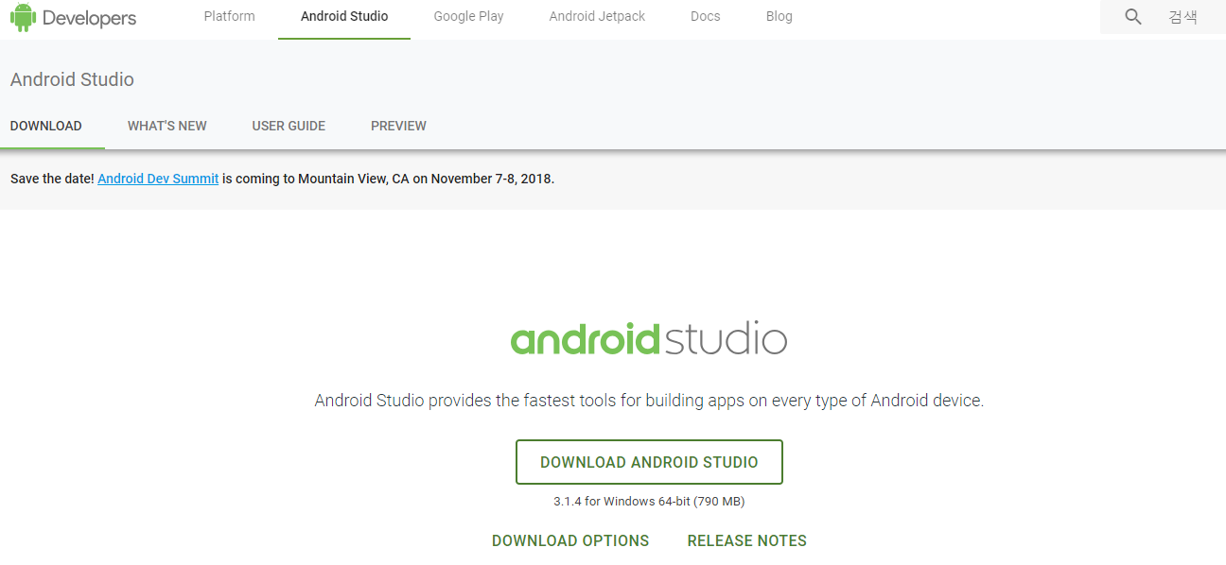
Environment for Development
Requirement
JDK 8
Android Studio install

Slide 4
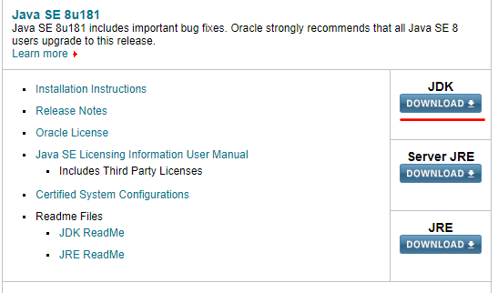
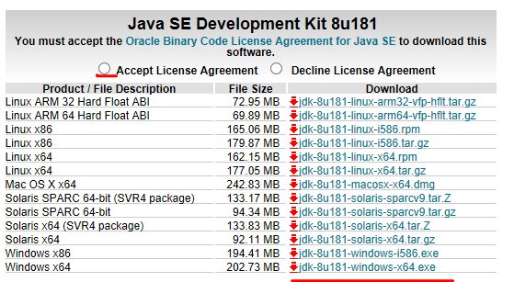
Environment for Development
JDK 8 install
Download: https://www.oracle.com/technetwork/java/javase/downloads/index.html
Execute downloaded file
Set java environment variable
1
2
3

Slide 5
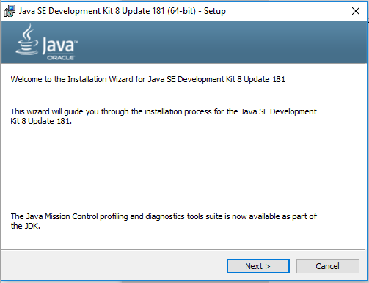
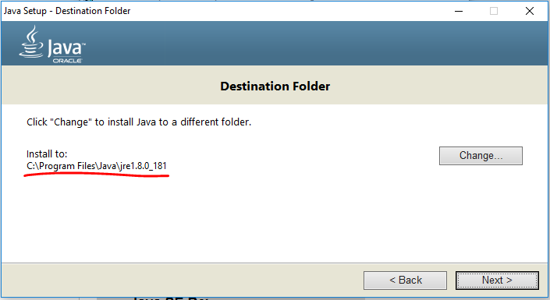
Environment for Development
JDK 8 install
Download: https://www.oracle.com/technetwork/java/javase/downloads/index.html
Execute downloaded file
Download JDK
Download JRE
Set java environment variable

Slide 6
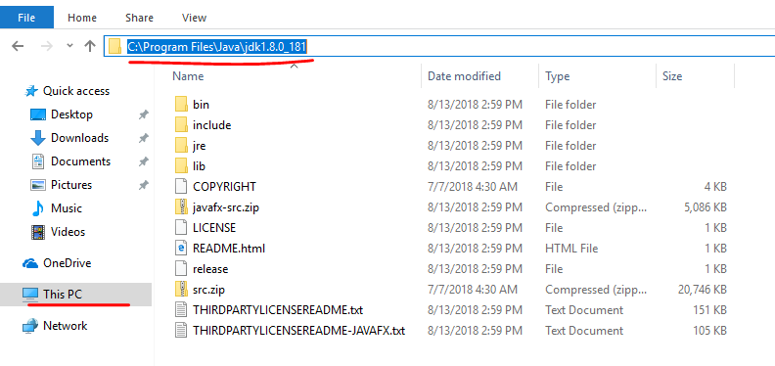
Environment for Development
JDK 8 install
Download: https://www.oracle.com/technetwork/java/javase/downloads/index.html
Execute downloaded file
Download JDK
Download JRE
Set java environment variable
Copy JDK folder location
Open environment variables window
Set JAVA_HOME
2
1

Slide 7
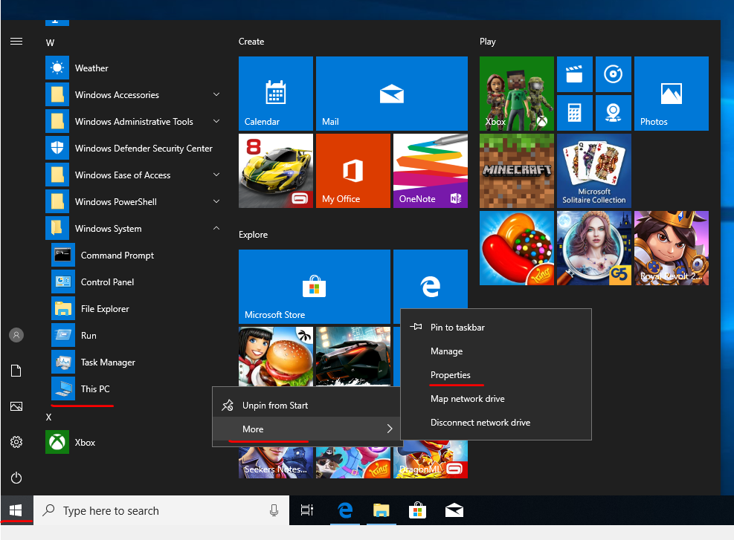
Environment for Development
JDK 8 install
Download: https://www.oracle.com/technetwork/java/javase/downloads/index.html
Execute downloaded file
Download JDK
Download JRE
Set java environment variable
Copy JDK folder location
Open environment variables window
On this PC click right mouse
Set JAVA_HOME
1
3
2

Slide 8
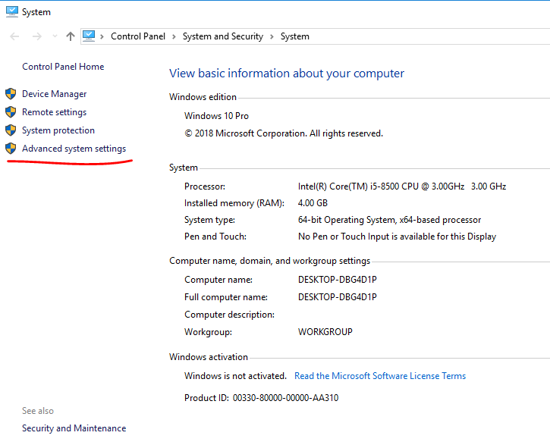
Environment for Development
JDK 8 install
Download: https://www.oracle.com/technetwork/java/javase/downloads/index.html
Execute downloaded file
Download JDK
Download JRE
Set java environment variable
Copy JDK folder location
Open environment variables window
Set JAVA_HOME

Slide 9
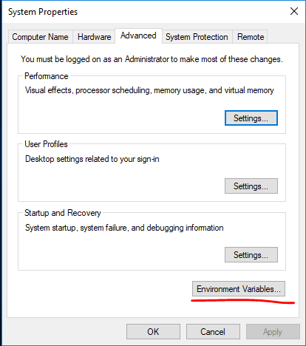
Environment for Development
JDK 8 install
Download: https://www.oracle.com/technetwork/java/javase/downloads/index.html
Execute downloaded file
Download JDK
Download JRE
Set java environment variable
Copy JDK folder location
Open environment variables window
Set JAVA_HOME

Slide 10
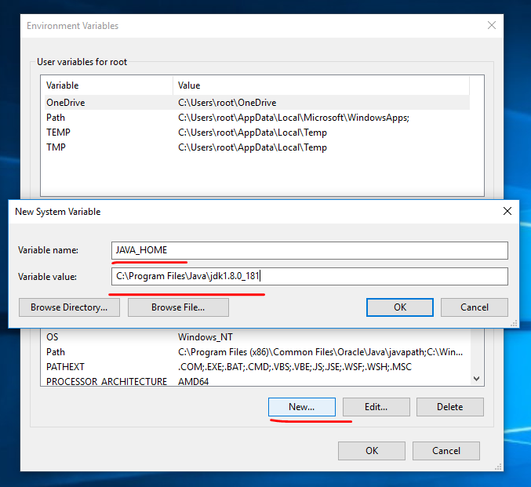
Environment for Development
JDK 8 install
Download: https://www.oracle.com/technetwork/java/javase/downloads/index.html
Execute downloaded file
Download JDK
Download JRE
Set java environment variable
Copy JDK folder location
Open environment variables window
Set JAVA_HOME
Set Path
2
3
1

Slide 11
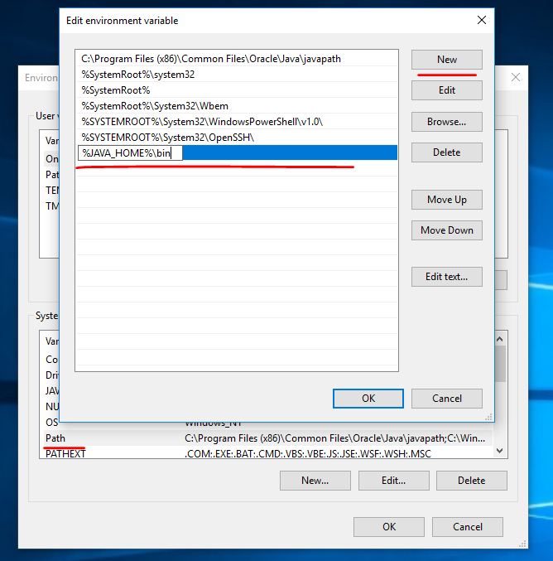
Environment for Development
JDK 8 install
Download: https://www.oracle.com/technetwork/java/javase/downloads/index.html
Execute downloaded file
Download JDK
Download JRE
Set java environment variable
Copy JDK folder location
Open environment variables window
Set JAVA_HOME
Set Path
2
3
1

Slide 12
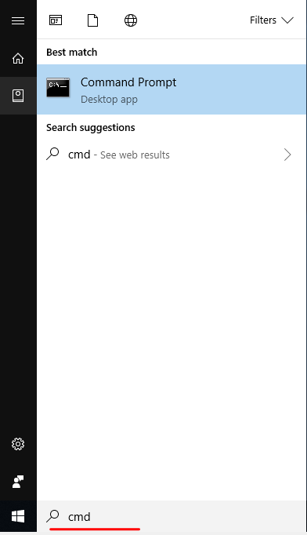
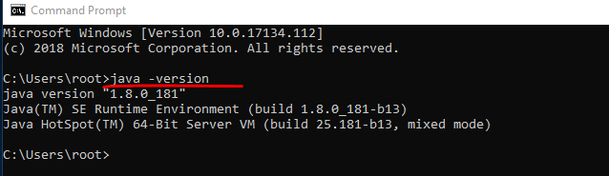
Environment for Development
JDK 8 install
Verify
2
3
1

Slide 13
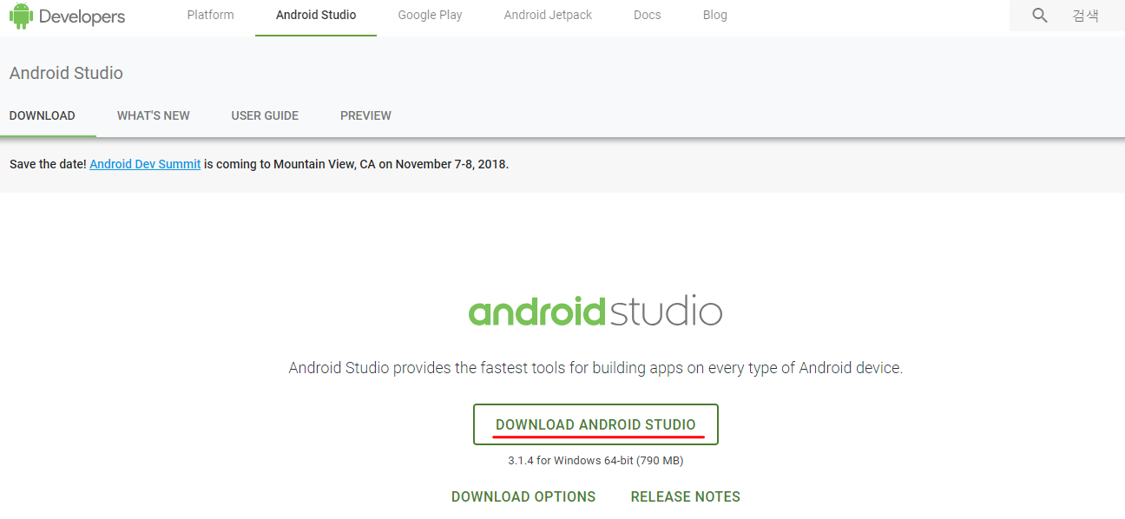
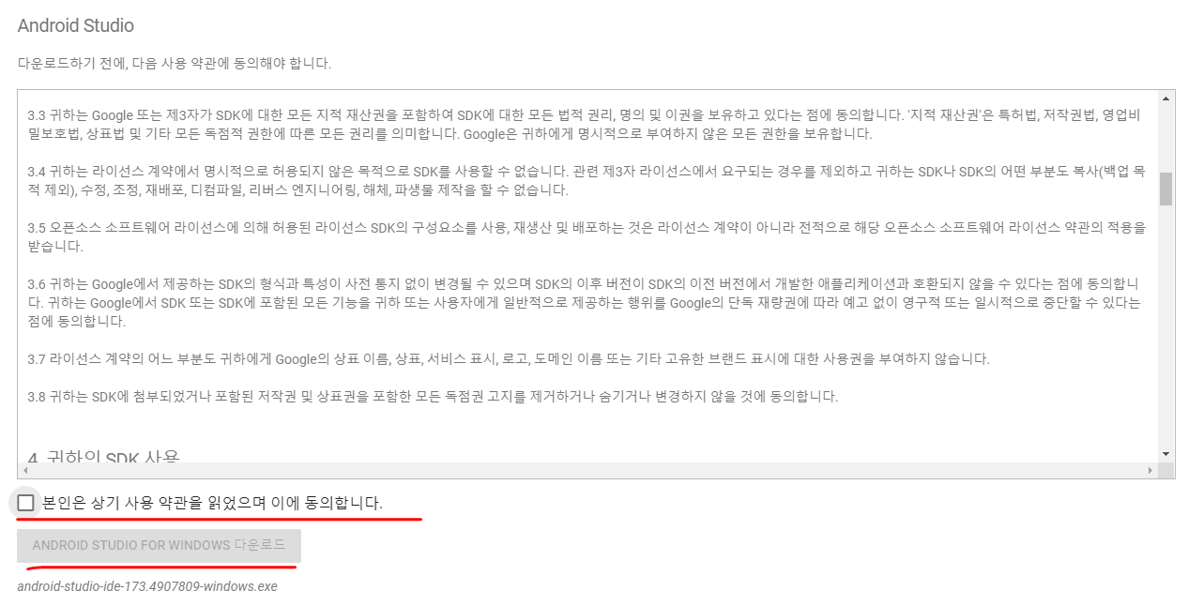
Environment for Development
Android Studio install
Download exe installer
Execute exe file

Slide 14
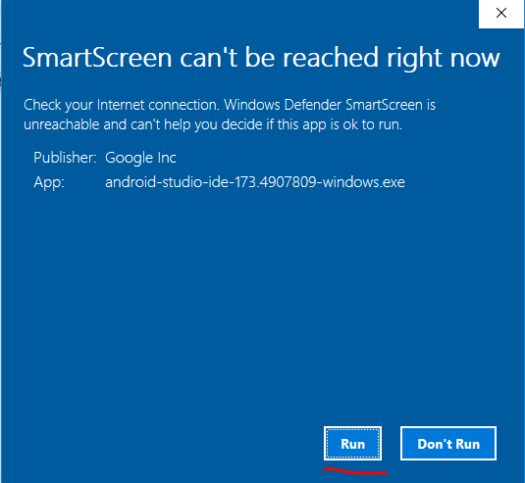
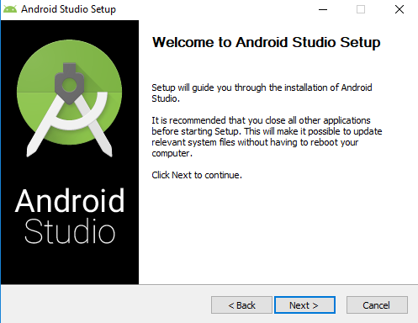
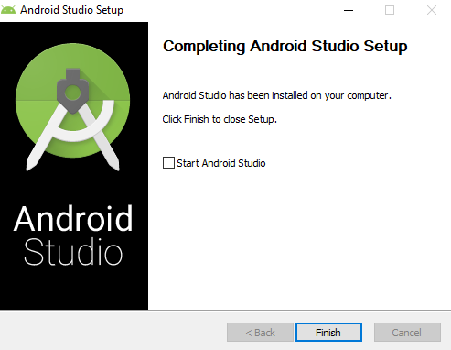
Environment for Development
Android Studio install
Download exe installer
Execute exe file

Slide 15
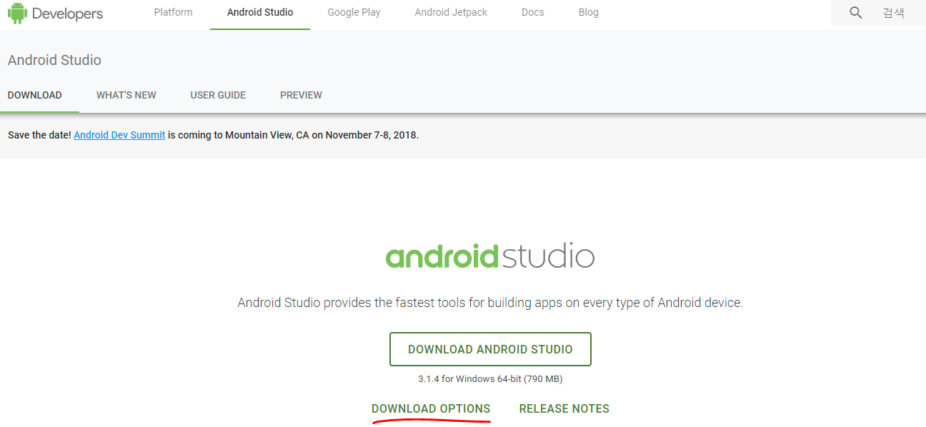
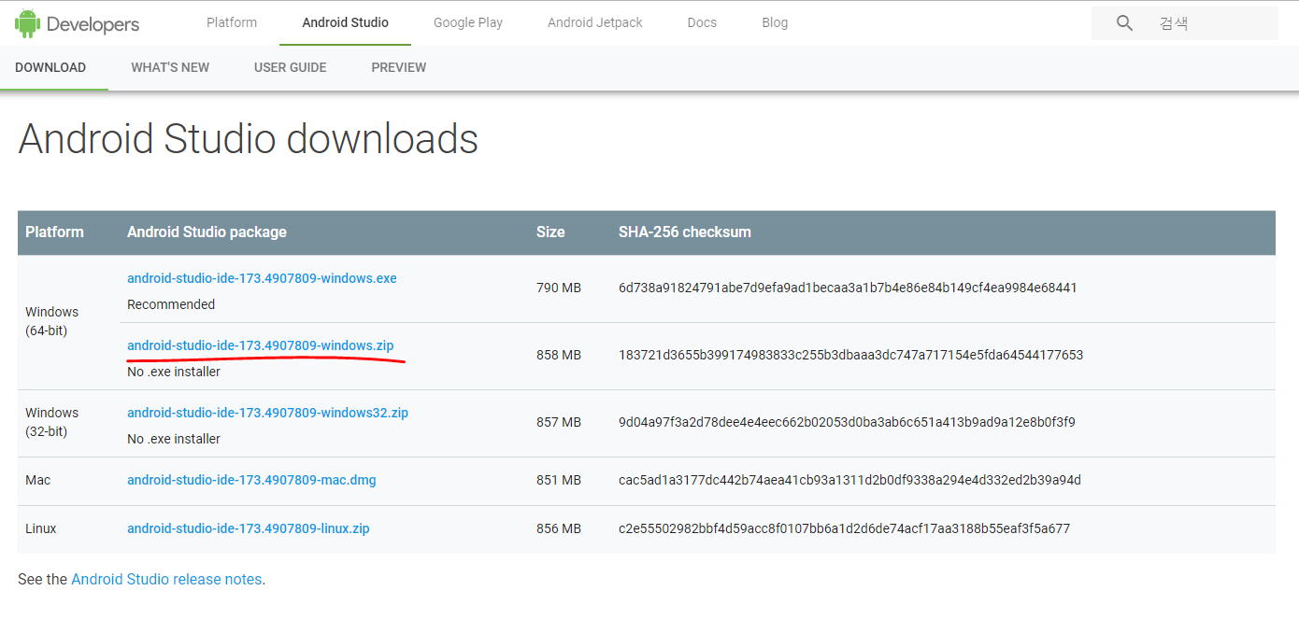
Environment for Development
Android Studio install
Download zip file
Select download options
Choose one that suit with your environment
Unzip downloaded file

Slide 16
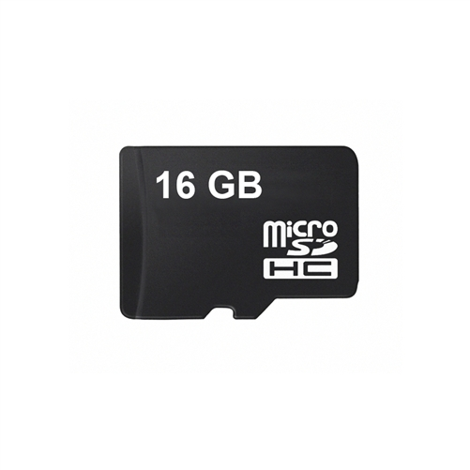
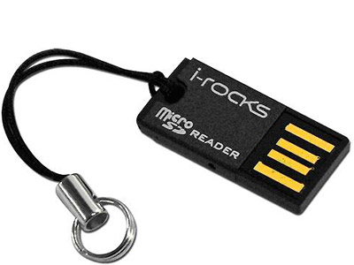
Environment for Raspberry Pi 3 Model B
Android Things: IoT operating system which derived form Android.
Let you develop apps for your devices with existing android development tools, APIs, and resources.
Flashing android things image to device
required
Android Things Setup Utility or Win32diskImage
microSD card larger than 8GB
MicroSD Card
MicroSD Card Reader

Slide 17
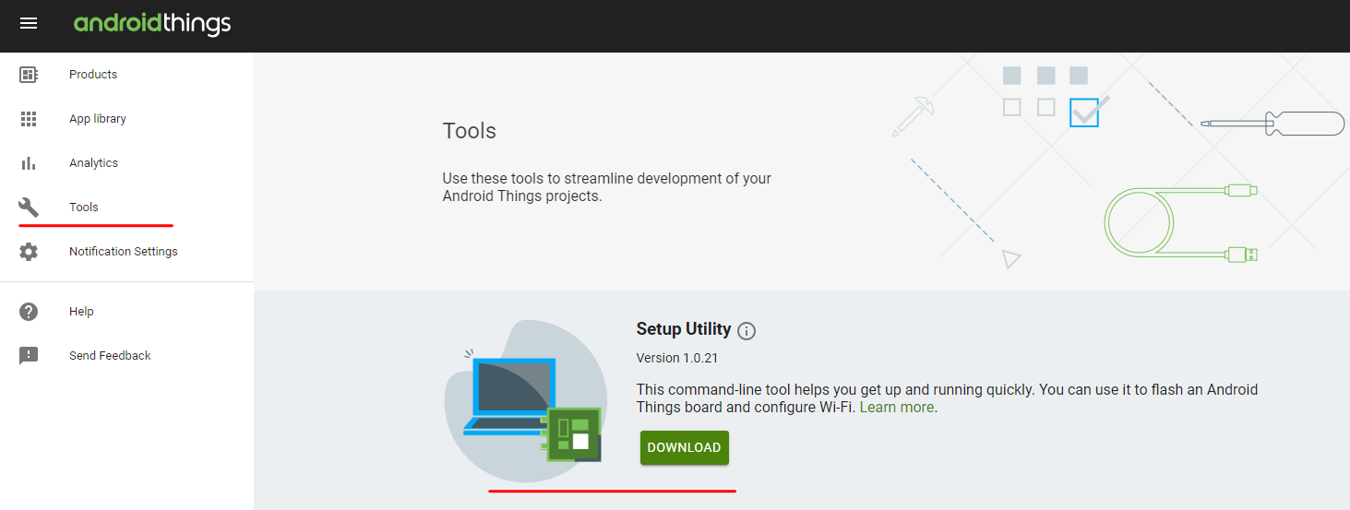
Environment for Raspberry Pi 3 Model B
Using Utility
Download and Unzip : https://partner.android.com/things/console#/tools
Unzip
Execute Tool
Write AndroidThings to Micro Card
Select actions
Select hardware
Select image
Select Micro SD card to install take several minutes
Notes:
Android Things Console: Can push your own app updates to devices using the Android Things Console.
Provides tools to install and update the system image on supported hardware devices. This allows you to push updates to users, test deployments on your own hardware.
Prerequisite: google account
Create an Android Things Product
Configure Product
Add models: you can use models to create variants of application builds that all run on the same underlying hardware
Change product settings
Share products with other console users
Create a device build
Name build configuration
Select Android Things version
Select applications you developed or google serviced
Add additional build resources
Edit hardware configurations: allow you to define peripherals and configure their attributes
Edit partition size
Adb tool location hidden use terminal cd to there
C:\Users\youngwook\AppData\Local\Android\Sdk\platform-tools> adb connect <ip-address> or adb connect android.local

Slide 18
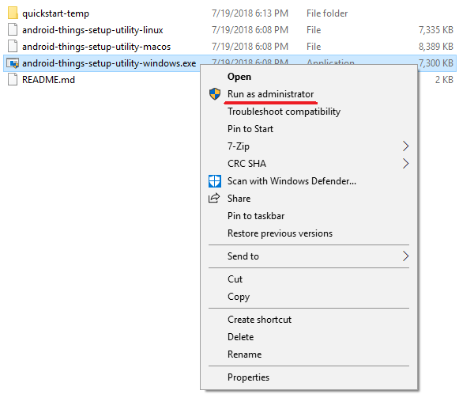
Environment for Raspberry Pi 3 Model B
Using Utility
Download and Unzip
Execute Tool
Connect Micro Card Reader with Computer
Run as administrator
Write AndroidThings to Micro Card
Select actions
Select hardware
Select image
Select Micro SD card to install take several minutes
Notes:
Android Things Console: Can push your own app updates to devices using the Android Things Console.
Provides tools to install and update the system image on supported hardware devices. This allows you to push updates to users, test deployments on your own hardware.
Prerequisite: google account
Create an Android Things Product
Configure Product
Add models: you can use models to create variants of application builds that all run on the same underlying hardware
Change product settings
Share products with other console users
Create a device build
Name build configuration
Select Android Things version
Select applications you developed or google serviced
Add additional build resources
Edit hardware configurations: allow you to define peripherals and configure their attributes
Edit partition size
Adb tool location hidden use terminal cd to there
C:\Users\youngwook\AppData\Local\Android\Sdk\platform-tools> adb connect <ip-address> or adb connect android.local

Slide 19
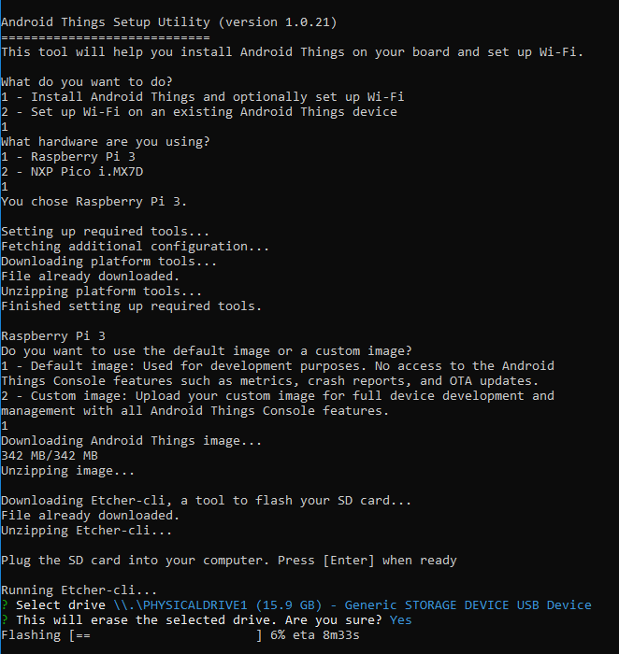
Environment for Raspberry Pi 3 Model B
Using Utility
Download and Unzip
Execute Tool
Write AndroidThings to Micro Card
Select actions
Select hardware
Select image
Select Micro SD card to install take several minutes
Notes:
Android Things Console: Can push your own app updates to devices using the Android Things Console.
Provides tools to install and update the system image on supported hardware devices. This allows you to push updates to users, test deployments on your own hardware.
Prerequisite: google account
Create an Android Things Product
Configure Product
Add models: you can use models to create variants of application builds that all run on the same underlying hardware
Change product settings
Share products with other console users
Create a device build
Name build configuration
Select Android Things version
Select applications you developed or google serviced
Add additional build resources
Edit hardware configurations: allow you to define peripherals and configure their attributes
Edit partition size
Adb tool location hidden use terminal cd to there
C:\Users\youngwook\AppData\Local\Android\Sdk\platform-tools> adb connect <ip-address> or adb connect android.local

Slide 20
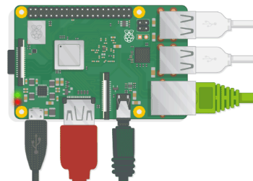
Environment for Raspberry Pi 3 Model B
Using Utility
Verify
Connect Raspberry Pi with Peripherals(mouse, keyboard, monitor, power, SD Card, Ethernet Cable)
USB Port
Micro SD Card
Ethernet port
Power
HDMI port
Notes:
Android Things Console: Can push your own app updates to devices using the Android Things Console.
Provides tools to install and update the system image on supported hardware devices. This allows you to push updates to users, test deployments on your own hardware.
Prerequisite: google account
Create an Android Things Product
Configure Product
Add models: you can use models to create variants of application builds that all run on the same underlying hardware
Change product settings
Share products with other console users
Create a device build
Name build configuration
Select Android Things version
Select applications you developed or google serviced
Add additional build resources
Edit hardware configurations: allow you to define peripherals and configure their attributes
Edit partition size
Adb tool location hidden use terminal cd to there
C:\Users\youngwook\AppData\Local\Android\Sdk\platform-tools> adb connect <ip-address> or adb connect android.local

Slide 21
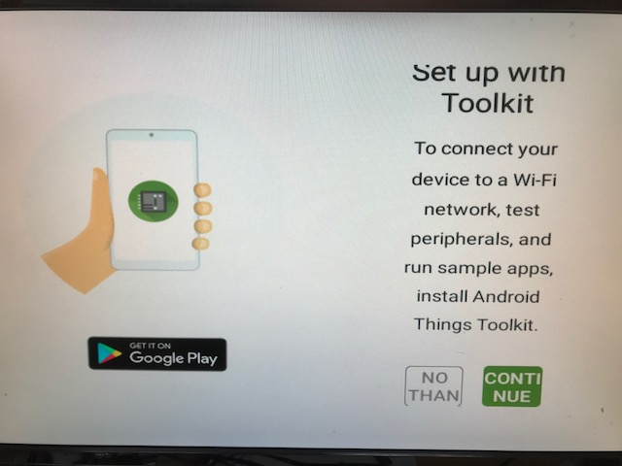
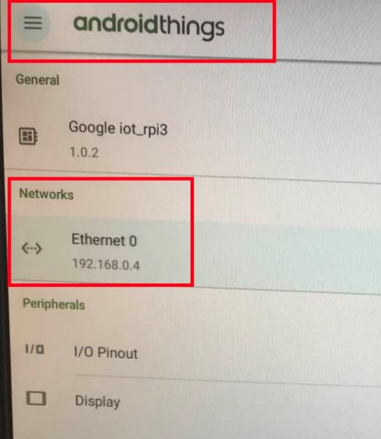
Environment for Raspberry Pi 3 Model B
Using Utility
Verify
Notes:
Android Things Console: Can push your own app updates to devices using the Android Things Console.
Provides tools to install and update the system image on supported hardware devices. This allows you to push updates to users, test deployments on your own hardware.
Prerequisite: google account
Create an Android Things Product
Configure Product
Add models: you can use models to create variants of application builds that all run on the same underlying hardware
Change product settings
Share products with other console users
Create a device build
Name build configuration
Select Android Things version
Select applications you developed or google serviced
Add additional build resources
Edit hardware configurations: allow you to define peripherals and configure their attributes
Edit partition size
Adb tool location hidden use terminal cd to there
C:\Users\youngwook\AppData\Local\Android\Sdk\platform-tools> adb connect <ip-address> or adb connect android.local

Slide 22
Environment for Raspberry Pi 3 Model B
Using Win32diskImage
Download Win32diskImage
Download image of android things
Write Image to Micro SD card
Notes:
Android Things Console: Can push your own app updates to devices using the Android Things Console.
Provides tools to install and update the system image on supported hardware devices. This allows you to push updates to users, test deployments on your own hardware.
Prerequisite: google account
Create an Android Things Product
Configure Product
Add models: you can use models to create variants of application builds that all run on the same underlying hardware
Change product settings
Share products with other console users
Create a device build
Name build configuration
Select Android Things version
Select applications you developed or google serviced
Add additional build resources
Edit hardware configurations: allow you to define peripherals and configure their attributes
Edit partition size
Adb tool location hidden use terminal cd to there
C:\Users\youngwook\AppData\Local\Android\Sdk\platform-tools> adb connect <ip-address> or adb connect android.local

Slide 23
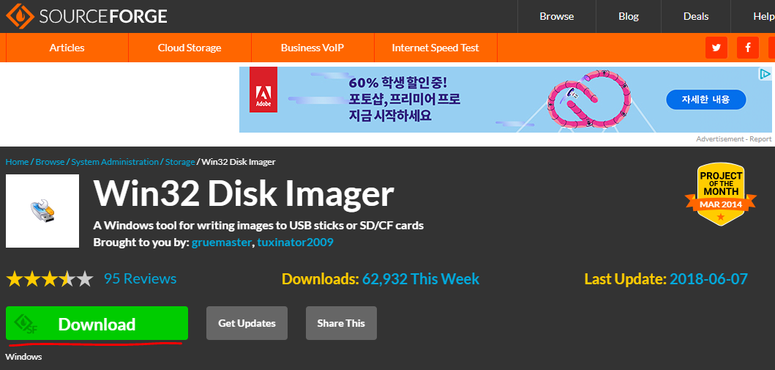
Environment for Raspberry Pi 3 Model B
Using Win32diskImage
Download Win32diskImage
https://sourceforge.net/projects/win32diskimager/
Download image of android things
Write Image to Micro SD card
Notes:
Android Things Console: Can push your own app updates to devices using the Android Things Console.
Provides tools to install and update the system image on supported hardware devices. This allows you to push updates to users, test deployments on your own hardware.
Prerequisite: google account
Create an Android Things Product
Configure Product
Add models: you can use models to create variants of application builds that all run on the same underlying hardware
Change product settings
Share products with other console users
Create a device build
Name build configuration
Select Android Things version
Select applications you developed or google serviced
Add additional build resources
Edit hardware configurations: allow you to define peripherals and configure their attributes
Edit partition size
Adb tool location hidden use terminal cd to there
C:\Users\youngwook\AppData\Local\Android\Sdk\platform-tools> adb connect <ip-address> or adb connect android.local

Slide 24
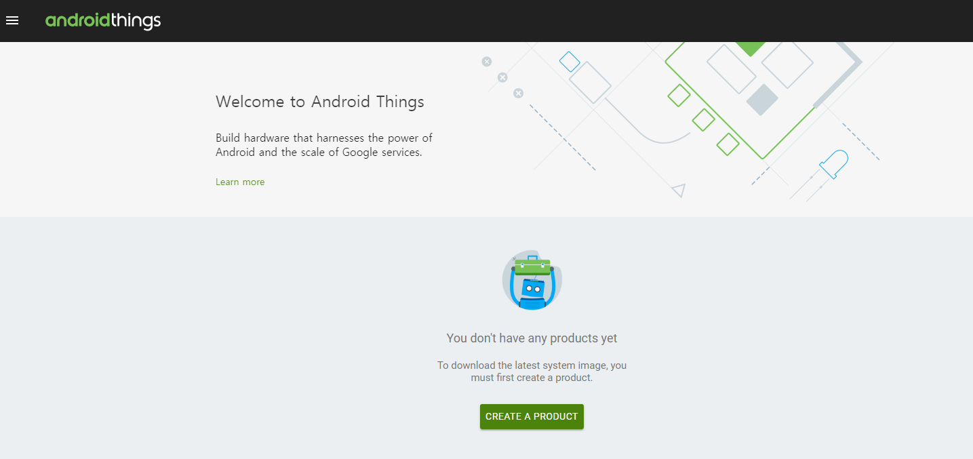
Environment for Raspberry Pi 3 Model B
Using Win32diskImage
Download Win32diskImage
Download image of android things
Create an Android Things product
Create device build
Download Image
Write Image to Micro SD card
Notes:
Android Things Console: Can push your own app updates to devices using the Android Things Console.
Provides tools to install and update the system image on supported hardware devices. This allows you to push updates to users, test deployments on your own hardware.
Prerequisite: google account
Create an Android Things Product
Configure Product
Add models: you can use models to create variants of application builds that all run on the same underlying hardware
Change product settings
Share products with other console users
Create a device build
Name build configuration
Select Android Things version
Select applications you developed or google serviced
Add additional build resources
Edit hardware configurations: allow you to define peripherals and configure their attributes
Edit partition size
Adb tool location hidden use terminal cd to there
C:\Users\youngwook\AppData\Local\Android\Sdk\platform-tools> adb connect <ip-address> or adb connect android.local

Slide 25
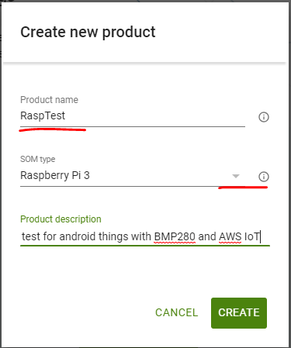
Environment for Raspberry Pi 3 Model B
Using Win32diskImage
Download Win32diskImage
Download image of android things
Create an Android Things product
Create device build
Download Image
Write Image to Micro SD card
Notes:
Android Things Console: Can push your own app updates to devices using the Android Things Console.
Provides tools to install and update the system image on supported hardware devices. This allows you to push updates to users, test deployments on your own hardware.
Prerequisite: google account
Create an Android Things Product
Configure Product
Add models: you can use models to create variants of application builds that all run on the same underlying hardware
Change product settings
Share products with other console users
Create a device build
Name build configuration
Select Android Things version
Select applications you developed or google serviced
Add additional build resources
Edit hardware configurations: allow you to define peripherals and configure their attributes
Edit partition size
Adb tool location hidden use terminal cd to there
C:\Users\youngwook\AppData\Local\Android\Sdk\platform-tools> adb connect <ip-address> or adb connect android.local

Slide 26
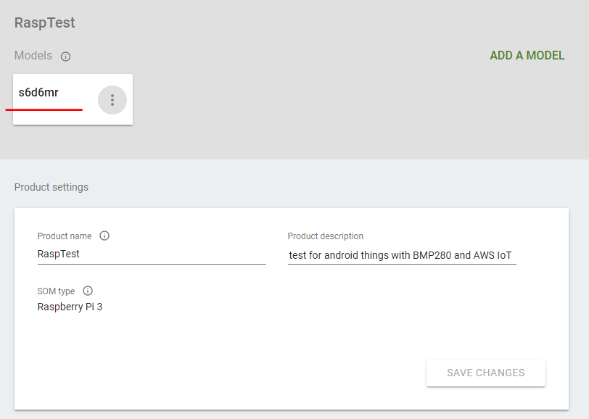
Environment for Raspberry Pi 3 Model B
Using Win32diskImage
Download Win32diskImage
Download image of android things
Create an Android Things product
Create device build
Download Image
Write Image to Micro SD card
Notes:
Android Things Console: Can push your own app updates to devices using the Android Things Console.
Provides tools to install and update the system image on supported hardware devices. This allows you to push updates to users, test deployments on your own hardware.
Prerequisite: google account
Create an Android Things Product
Configure Product
Add models: you can use models to create variants of application builds that all run on the same underlying hardware
Change product settings
Share products with other console users
Create a device build
Name build configuration
Select Android Things version
Select applications you developed or google serviced
Add additional build resources
Edit hardware configurations: allow you to define peripherals and configure their attributes
Edit partition size
Adb tool location hidden use terminal cd to there
C:\Users\youngwook\AppData\Local\Android\Sdk\platform-tools> adb connect <ip-address> or adb connect android.local

Slide 27
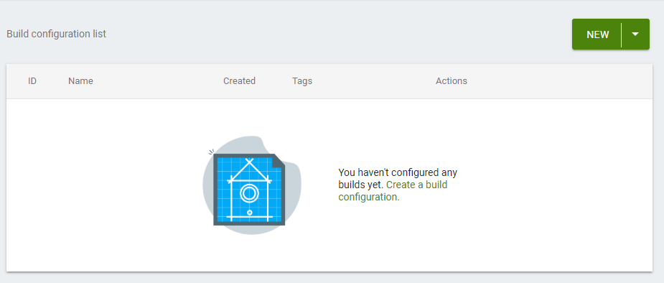
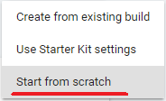
Environment for Raspberry Pi 3 Model B
Using Win32diskImage
Download Win32diskImage
Download image of android things
Create an Android Things product
Create device build
Download Image
Write Image to Micro SD card
Notes:
Android Things Console: Can push your own app updates to devices using the Android Things Console.
Provides tools to install and update the system image on supported hardware devices. This allows you to push updates to users, test deployments on your own hardware.
Prerequisite: google account
Create an Android Things Product
Configure Product
Add models: you can use models to create variants of application builds that all run on the same underlying hardware
Change product settings
Share products with other console users
Create a device build
Name build configuration
Select Android Things version
Select applications you developed or google serviced
Add additional build resources
Edit hardware configurations: allow you to define peripherals and configure their attributes
Edit partition size
Adb tool location hidden use terminal cd to there
C:\Users\youngwook\AppData\Local\Android\Sdk\platform-tools> adb connect <ip-address> or adb connect android.local

Slide 28
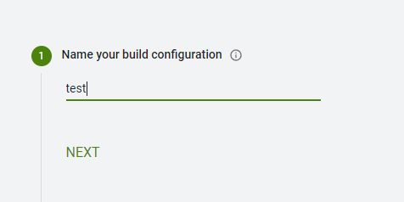
Environment for Raspberry Pi 3 Model B
Using Win32diskImage
Download Win32diskImage
Download image of android things
Create an Android Things product
Create device build
Download Image
Write Image to Micro SD card
Notes:
Android Things Console: Can push your own app updates to devices using the Android Things Console.
Provides tools to install and update the system image on supported hardware devices. This allows you to push updates to users, test deployments on your own hardware.
Prerequisite: google account
Create an Android Things Product
Configure Product
Add models: you can use models to create variants of application builds that all run on the same underlying hardware
Change product settings
Share products with other console users
Create a device build
Name build configuration
Select Android Things version
Select applications you developed or google serviced
Add additional build resources
Edit hardware configurations: allow you to define peripherals and configure their attributes
Edit partition size
Adb tool location hidden use terminal cd to there
C:\Users\youngwook\AppData\Local\Android\Sdk\platform-tools> adb connect <ip-address> or adb connect android.local

Slide 29
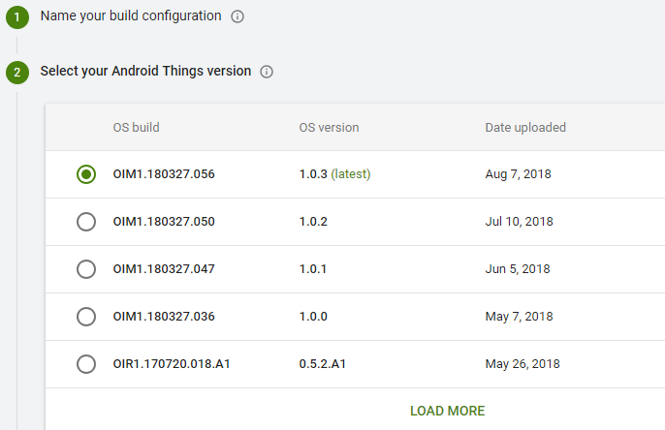
Environment for Raspberry Pi 3 Model B
Using Win32diskImage
Download Win32diskImage
Download image of android things
Create an Android Things product
Create device build
Download Image
Write Image to Micro SD card
Notes:
Android Things Console: Can push your own app updates to devices using the Android Things Console.
Provides tools to install and update the system image on supported hardware devices. This allows you to push updates to users, test deployments on your own hardware.
Prerequisite: google account
Create an Android Things Product
Configure Product
Add models: you can use models to create variants of application builds that all run on the same underlying hardware
Change product settings
Share products with other console users
Create a device build
Name build configuration
Select Android Things version
Select applications you developed or google serviced
Add additional build resources
Edit hardware configurations: allow you to define peripherals and configure their attributes
Edit partition size
Adb tool location hidden use terminal cd to there
C:\Users\youngwook\AppData\Local\Android\Sdk\platform-tools> adb connect <ip-address> or adb connect android.local

Slide 30
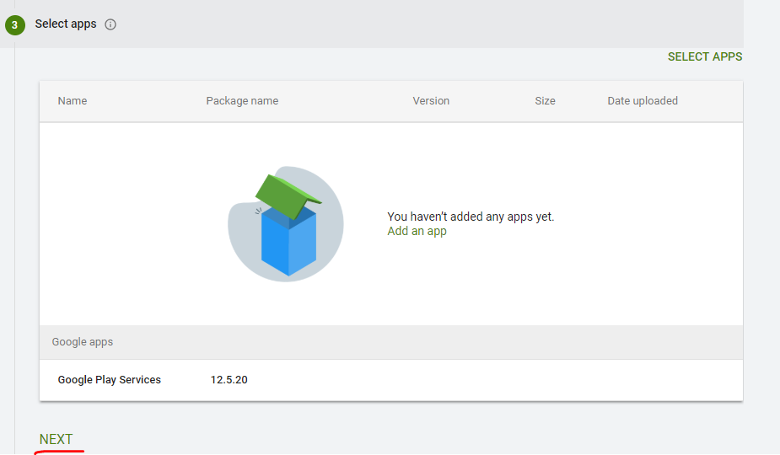
Environment for Raspberry Pi 3 Model B
Using Win32diskImage
Download Win32diskImage
Download image of android things
Create an Android Things product
Create device build
Download Image
Write Image to Micro SD card
Notes:
Android Things Console: Can push your own app updates to devices using the Android Things Console.
Provides tools to install and update the system image on supported hardware devices. This allows you to push updates to users, test deployments on your own hardware.
Prerequisite: google account
Create an Android Things Product
Configure Product
Add models: you can use models to create variants of application builds that all run on the same underlying hardware
Change product settings
Share products with other console users
Create a device build
Name build configuration
Select Android Things version
Select applications you developed or google serviced
Add additional build resources
Edit hardware configurations: allow you to define peripherals and configure their attributes
Edit partition size
Adb tool location hidden use terminal cd to there
C:\Users\youngwook\AppData\Local\Android\Sdk\platform-tools> adb connect <ip-address> or adb connect android.local

Slide 31
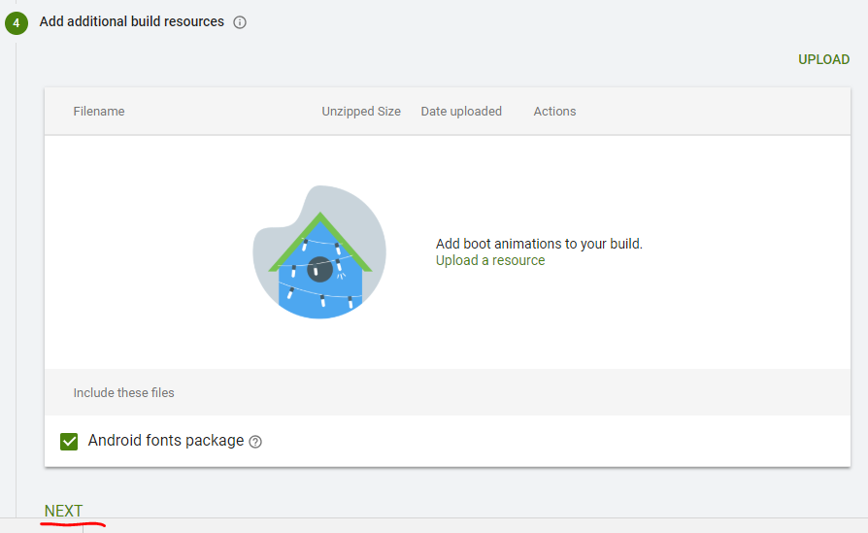
Environment for Raspberry Pi 3 Model B
Using Win32diskImage
Download Win32diskImage
Download image of android things
Create an Android Things product
Create device build
Download Image
Write Image to Micro SD card
Notes:
Android Things Console: Can push your own app updates to devices using the Android Things Console.
Provides tools to install and update the system image on supported hardware devices. This allows you to push updates to users, test deployments on your own hardware.
Prerequisite: google account
Create an Android Things Product
Configure Product
Add models: you can use models to create variants of application builds that all run on the same underlying hardware
Change product settings
Share products with other console users
Create a device build
Name build configuration
Select Android Things version
Select applications you developed or google serviced
Add additional build resources
Edit hardware configurations: allow you to define peripherals and configure their attributes
Edit partition size
Adb tool location hidden use terminal cd to there
C:\Users\youngwook\AppData\Local\Android\Sdk\platform-tools> adb connect <ip-address> or adb connect android.local

Slide 32
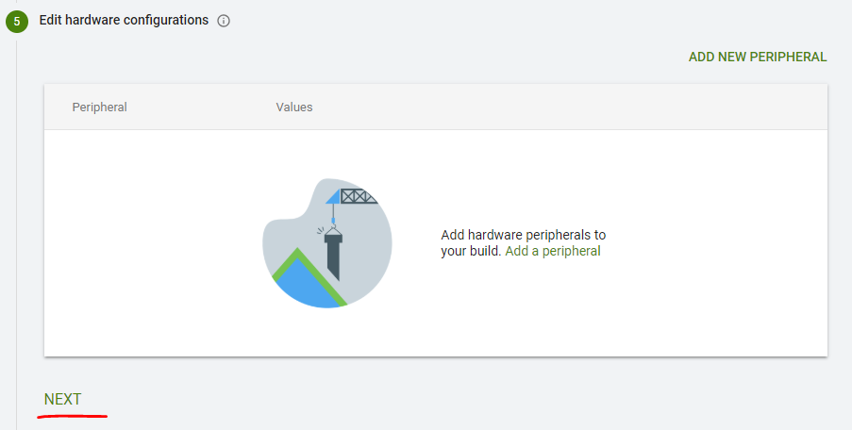
Environment for Raspberry Pi 3 Model B
Using Win32diskImage
Download Win32diskImage
Download image of android things
Create an Android Things product
Create device build
Download Image
Write Image to Micro SD card
Notes:
Android Things Console: Can push your own app updates to devices using the Android Things Console.
Provides tools to install and update the system image on supported hardware devices. This allows you to push updates to users, test deployments on your own hardware.
Prerequisite: google account
Create an Android Things Product
Configure Product
Add models: you can use models to create variants of application builds that all run on the same underlying hardware
Change product settings
Share products with other console users
Create a device build
Name build configuration
Select Android Things version
Select applications you developed or google serviced
Add additional build resources
Edit hardware configurations: allow you to define peripherals and configure their attributes
Edit partition size
Adb tool location hidden use terminal cd to there
C:\Users\youngwook\AppData\Local\Android\Sdk\platform-tools> adb connect <ip-address> or adb connect android.local

Slide 33
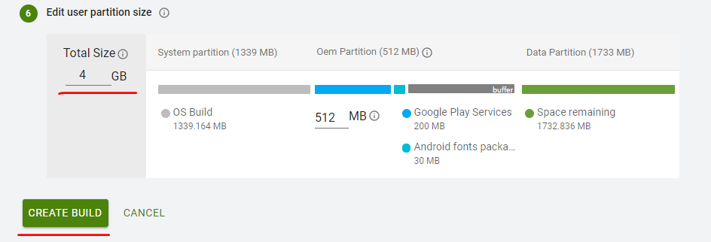
Environment for Raspberry Pi 3 Model B
Using Win32diskImage
Download Win32diskImage
Download image of android things
Create an Android Things product
Create device build
Download Image
Write Image to Micro SD card
Notes:
Android Things Console: Can push your own app updates to devices using the Android Things Console.
Provides tools to install and update the system image on supported hardware devices. This allows you to push updates to users, test deployments on your own hardware.
Prerequisite: google account
Create an Android Things Product
Configure Product
Add models: you can use models to create variants of application builds that all run on the same underlying hardware
Change product settings
Share products with other console users
Create a device build
Name build configuration
Select Android Things version
Select applications you developed or google serviced
Add additional build resources
Edit hardware configurations: allow you to define peripherals and configure their attributes
Edit partition size
Adb tool location hidden use terminal cd to there
C:\Users\youngwook\AppData\Local\Android\Sdk\platform-tools> adb connect <ip-address> or adb connect android.local

Slide 34
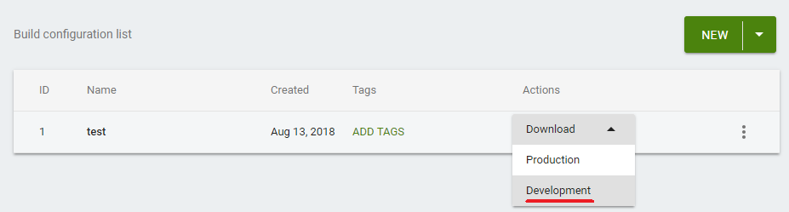
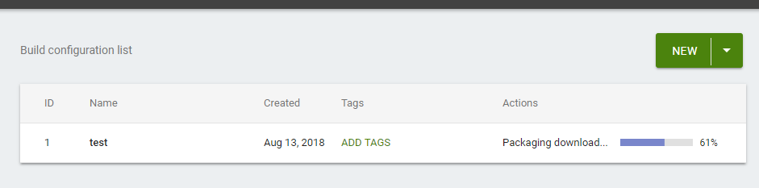
Environment for Raspberry Pi 3 Model B
Using Win32diskImage
Download Win32diskImage
Download image of android things
Create an Android Things product
Create device build
Download Image
Write Image to Micro SD card
Notes:
Android Things Console: Can push your own app updates to devices using the Android Things Console.
Provides tools to install and update the system image on supported hardware devices. This allows you to push updates to users, test deployments on your own hardware.
Prerequisite: google account
Create an Android Things Product
Configure Product
Add models: you can use models to create variants of application builds that all run on the same underlying hardware
Change product settings
Share products with other console users
Create a device build
Name build configuration
Select Android Things version
Select applications you developed or google serviced
Add additional build resources
Edit hardware configurations: allow you to define peripherals and configure their attributes
Edit partition size
Adb tool location hidden use terminal cd to there
C:\Users\youngwook\AppData\Local\Android\Sdk\platform-tools> adb connect <ip-address> or adb connect android.local

Slide 35
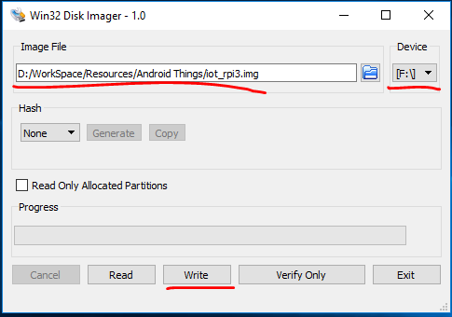
Environment for Raspberry Pi 3 Model B
Using Win32diskImage
Download Win32diskImage
Download image of android things
Create an Android Things product
Create device build
Download Image
Write Image to Micro SD card
Run Win32diskImage
Select image
Select SD card device
write it for SD card
Notes:
Android Things Console: Can push your own app updates to devices using the Android Things Console.
Provides tools to install and update the system image on supported hardware devices. This allows you to push updates to users, test deployments on your own hardware.
Prerequisite: google account
Create an Android Things Product
Configure Product
Add models: you can use models to create variants of application builds that all run on the same underlying hardware
Change product settings
Share products with other console users
Create a device build
Name build configuration
Select Android Things version
Select applications you developed or google serviced
Add additional build resources
Edit hardware configurations: allow you to define peripherals and configure their attributes
Edit partition size
Adb tool location hidden use terminal cd to there
C:\Users\youngwook\AppData\Local\Android\Sdk\platform-tools> adb connect <ip-address> or adb connect android.local

Slide 36
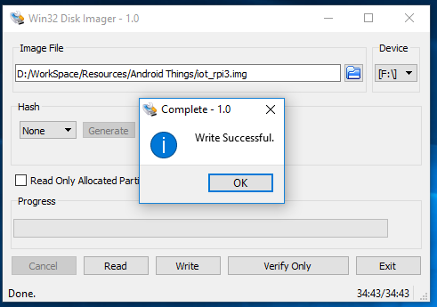
Environment for Raspberry Pi 3 Model B
Using Win32diskImage
Download Win32diskImage
Download image of android things
Create an Android Things product
Create device build
Download Image
Write Image to Micro SD card
Run Win32diskImage
Select image
Select SD card device
write it for SD card
Notes:
Android Things Console: Can push your own app updates to devices using the Android Things Console.
Provides tools to install and update the system image on supported hardware devices. This allows you to push updates to users, test deployments on your own hardware.
Prerequisite: google account
Create an Android Things Product
Configure Product
Add models: you can use models to create variants of application builds that all run on the same underlying hardware
Change product settings
Share products with other console users
Create a device build
Name build configuration
Select Android Things version
Select applications you developed or google serviced
Add additional build resources
Edit hardware configurations: allow you to define peripherals and configure their attributes
Edit partition size
Adb tool location hidden use terminal cd to there
C:\Users\youngwook\AppData\Local\Android\Sdk\platform-tools> adb connect <ip-address> or adb connect android.local

Slide 37
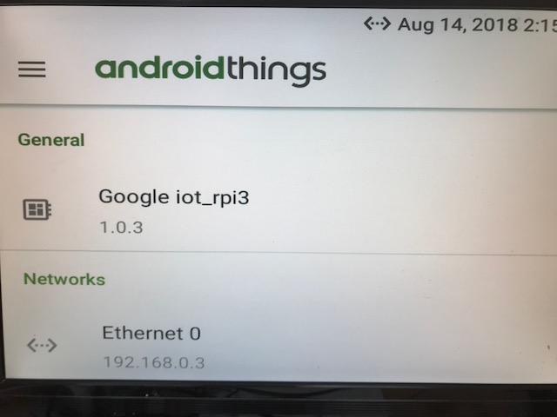
Environment for Raspberry Pi 3 Model B
Using Win32diskImage
Download Win32diskImage
Download image of android things
Create an Android Things product
Create device build
Download Image
Write Image to Micro SD card
Run Win32diskImage
Select image
Select SD card device
write it for SD card
Notes:
Android Things Console: Can push your own app updates to devices using the Android Things Console.
Provides tools to install and update the system image on supported hardware devices. This allows you to push updates to users, test deployments on your own hardware.
Prerequisite: google account
Create an Android Things Product
Configure Product
Add models: you can use models to create variants of application builds that all run on the same underlying hardware
Change product settings
Share products with other console users
Create a device build
Name build configuration
Select Android Things version
Select applications you developed or google serviced
Add additional build resources
Edit hardware configurations: allow you to define peripherals and configure their attributes
Edit partition size
Adb tool location hidden use terminal cd to there
C:\Users\youngwook\AppData\Local\Android\Sdk\platform-tools> adb connect <ip-address> or adb connect android.local

Slide 38
Environment for Raspberry Pi 3 Model B set BMP280
BMP280
Sensor for temperature and barometric pressure
Use with 3v or 5v logic microcontroller
Pins
Power Pins:
Vin: power pin
3v3: 3.3 V output from voltage regulator
GND: common ground for poser and logic
I2C Logic pins:
SCL: I2C clock pin
SDA: I2c data pin
Notes:
I2C(Inter Integrated Circuit communications)
Communication protocol for electronic parts
VDC(Volts Direct Current)

Slide 39
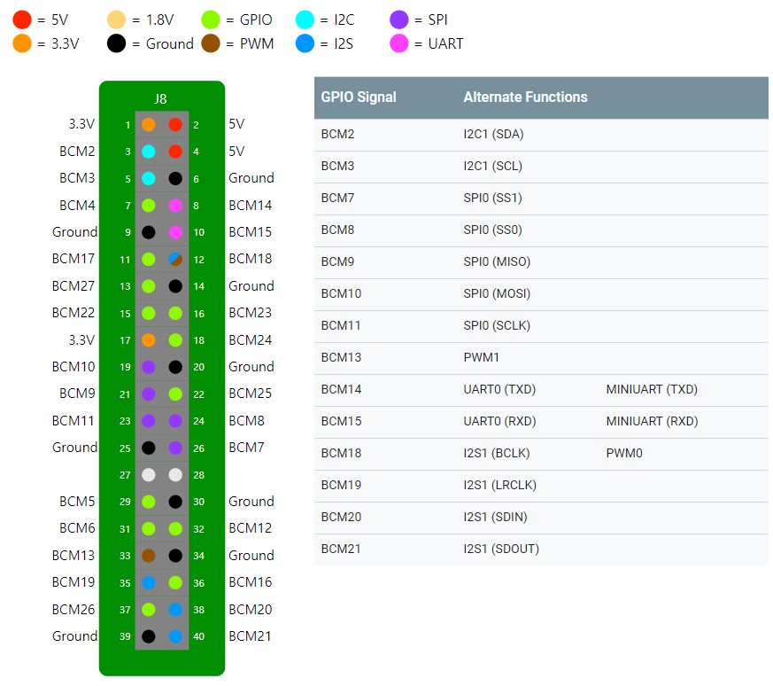
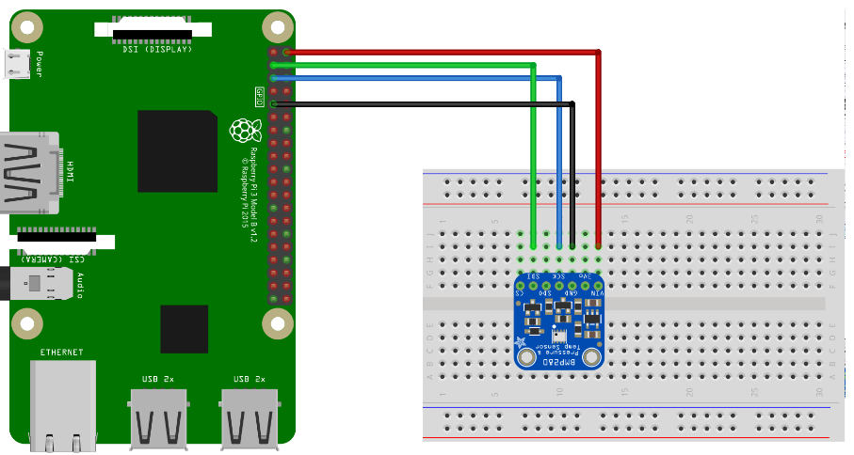
Environment for Raspberry Pi 3 Model B set BMP280 Schematics
Schematics: connection between raspberry pi and BMP280
Pins
Vin: pin number 2 of RaspBerry pi 3
GND: pin number 9 of RaspBerry pi 3
SCL: pin number 3 of RaspBerry pi 3
SDA: pin number 5 of RaspBerry pi 3

Slide 40
Reference
http://www.automationtestinghub.com/setup-java-environment-variables/
http://www.automationtestinghub.com/download-and-install-java/
https://github.com/androidthings/drivers-samples/tree/master/bmx280
https://github.com/androidthings/contrib-drivers/tree/master/bmx280

